Slide 1
Discrete Probability Distributions
Instructor
Muhammad Amjad
Assistant Professor , SS & H Dept.,
FAST-NU, Main Campus, Karachi
muhammad.amjad@nu.edu.pk

Slide 2
Discrete Probability Distributions
Binomial distribution
Multinomial distribution
Hypergeometric distribution
Poisson distribution
Geometric distribution

Slide 3
The Bernoulli Process
1. The experiment consists of repeated trials.
2. Each trial results in an outcome that may be classified as a success or failure.
3. The probability of success, denoted by p, remains constant from trial to trial.
4. The repeated trials are independent.
Notes:
Examples: Tossing a coin, Defective or Non defective, Pass/fail

Slide 4

Binomial Distribution
The number X of successes in n Bernoulli trials is called a binomial random variable.
The probability distribution of this discrete random variable is called the binomial distribution.
The probability of a success in a binomial experiment can be computed with this formula:

Slide 5
Examples 01 – 03
A coin is tossed 3 times. Find the probability of getting exactly two heads.
The probability that a certain kind of component will survive a shock test is 3/4. Find the probability that exactly 2 of the next 4 components tested survive.
The probability that a patient recovers from a rare blood disease is 0.4. If 15 people are known to have contracted this disease, what is the probability that
(a) at least 10 survive,
(b) from 3 to 8 survive, and
(c) exactly 5 survive?
Notes:
(1) 3/8 = 0.375
2) N=4, p = ¾, x = 2 P(x=2) = 27/128
(3) P(X>10)=0.0338 P(3 to 8) = 0.8779 P(X = 5) = 0.1859

Slide 6
Example # 04
A large chain retailer purchases a certain kind of electronic device from a manufacturer. The manufacturer indicates that the defective rate of the device is 3% .
(a) The inspector randomly picks 20 items from a shipment. What is the probability that there will be at least one defective item among these 20?
(b) Suppose that the retailer receives 10 shipments in a month and the inspector randomly tests 20 devices per shipment. What is the probability that there will be exactly 3 shipments each containing at least one defective device among the 20 that are selected and tested from the shipment?
Notes:
P(X>=1) = 1 – p(x=0) = 0.4562.
P = 0.4562 P(Y=3) = 0.1602

Slide 7
Example # 05 – 07
A coin is tossed 4 times. Find the mean, variance, and standard deviation of the number of heads that will be obtained.
Solve the above problem using the concept of expected values.
A die is rolled 480 times. Find the mean, variance, and standard deviation of the number of 3s that will be rolled.
Notes:
Mean = 2, var = 1
# Heads = X = (0, 1/16) (1, 4/16) (2, 6/16) (4/16) (1/16) E(x) = 2 =mean
(7) Mean = n p = 480(1/6) = 80 & sigma = 8.16

Slide 8
Multinomial Experiments
Each trial in an experiment has more than two outcomes.
the probabilities for each trial remain constant.
the outcomes are independent for a fixed number of trials.
Events must also be mutually exclusive.

Slide 9
Examples of Multinomial Experiments
52 playing cards.
Rolling a dice.
a survey might require the responses of “approve,” “disapprove,” or “no opinion.”

Slide 10
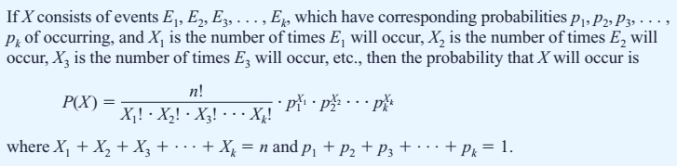
Multinomial Distribution

Slide 11
Example # 08: Leisure Activity
In a large city, 50% of the people choose a movie, 30% choose dinner and a play, and 20% choose shopping as a leisure activity. If a sample of 5 people is randomly selected, find the probability that 3 are planning to go to a movie, 1 to a play, and 1 to a shopping mall.
Notes:
n=5, x1=3, x2=1, x3=1
P(X) = 0.15

Slide 12
Example # 09: Coffee Shop Customers
A small airport coffee shop manager found that the probabilities a customer buys 0, 1, 2, or 3 cups of coffee are 0.3, 0.5, 0.15, and 0.05, respectively. If 8 customers enter the shop, find the probability that 2 will purchase something other than coffee, 4 will purchase 1 cup of coffee, 1 will purchase 2 cups, and 1 will purchase 3 cups.
Notes:
N=8, P(X) = 0.0354

Slide 13
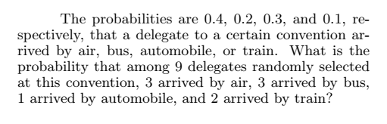
Example # 10: Arrival of delegation
Notes:
9c(3,3,1,2) = 0.0077.

Slide 14
Hypergeometric Experiment
The result of each trial can be classified as Success or Failure.
The probability of success changes on each trial.
Successive trials are dependent.
The experiment is repeated a fixed number of times.

Slide 15
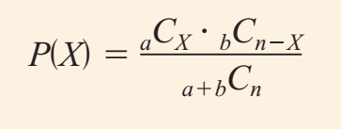
Hypergeometric Distribution
Given a population with only two types of objects (Success or failure), such that there are a items of one kind and b items of another kind and a b equals the total population, the probability P(X) of selecting without replacement a sample of size n with X items of type a and (n - X) items of type b is:

Slide 16
Example # 11 – 13
Assistant Manager Applicants: Ten people apply for a job as assistant manager of a restaurant. Five have completed college and five have not. If the manager selects 3 applicants at random, find the probability that all 3 are college graduates.
House Insurance: A recent study found that 2 out of every 10 houses in a neighborhood have no insurance. If 5 houses are selected from 10 houses, find the probability that exactly 1 will be uninsured.
Defective Compressor Tanks: A lot of 12 compressor tanks is checked to see whether there are any defective tanks. Three tanks are checked for leaks. If 1 or more of the 3 is defective, the lot is rejected. Find the probability that the lot will be rejected if there are actually 3 defective tanks in the lot.
Notes:
(11) 1/12
(12) 5/9
(13) 0.38 = 1(84)/220 and P(at least one defective = 1 – 0.38 = 0.618

Slide 17
Geometric Experiment
The outcomes of each experiment/trial can be classified into one of the two categories (Success or Failure).
The probability of a success is the same for each experiment.
Each experiment is independent of all the others.
The experiment is repeated a variable number of times until the first success is obtained.

Slide 18
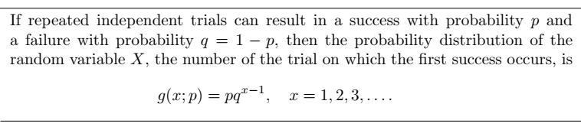
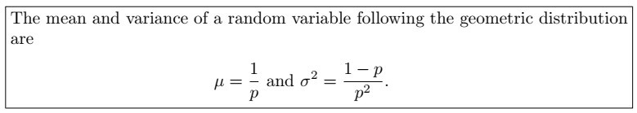
Geometric Distribution
Notes:
It has only one parameter i.e. “p”

Slide 19
Example 14 – 16
Manufacturing Process: For a certain manufacturing process, it is known that, on the average, 1 in every 100 items is defective. What is the probability that the fifth item inspected is the first defective item found?
Driver’s License: The probability is 0.85 that an applicant for a driver’s license will pass the road test on a given try. What is the probability that an applicant will finally pass the test on the 3rd try.
Busy Time: At a “busy time,” a telephone exchange is very near capacity, so callers have difficulty placing their calls. It may be of interest to know the number of attempts necessary in order to make a connection. Suppose that we let p = 0.05 be the probability of a connection during a busy time. We are interested in knowing the probability that 5 attempts are necessary for a successful call.
Notes:
(14) g(5, 0.01) = 0.0096
(15) g(3, 0.85) = 0.019125 = 0.02
(16) g(5, 0.05) = 0.041

Slide 20

Poisson Distribution
Another important discrete distribution that is often used to model the frequency with which a specified event occurs during a particular period, is Poisson distribution.
The Poisson probability formula is:
Where “X” is the number of times the event occurs and λ is a parameter equal to the mean of X.

Slide 21
Examples # 17 – 19
Radioactive Particles: During a laboratory experiment, the average number of radioactive particles passing through a counter in 1 millisecond is 4. What is the probability that 6 particles enter the counter in a given millisecond?
Oil Tankers arrival: Ten is the average number of oil tankers arriving each day at a certain port. The facilities at the port can handle at most 15 tankers per day. What is the probability that on a given day tankers have to be turned away?
Typographical Errors: If there are 200 typographical errors randomly distributed in a 500-page manuscript, find the probability that a given page contains exactly 3 errors.
Notes:
P(6, 4) = 0.1042.
P(X>15) = 1 – P(X<=15) = 1 – 0.9513 = 0.0487.
(19) Mean = 200/500 = 0.4 & P(X=3, mean = 0.4) = 0.0072

Slide 22
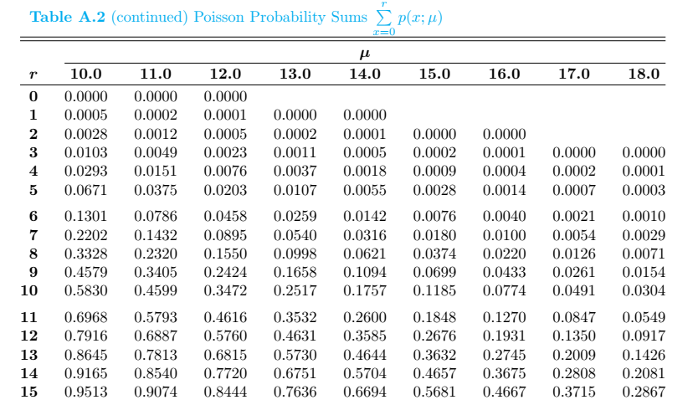

Slide 23
Example # 20: Toll – Free Telephone Calls
A sales firm receives, on average, 3 calls per hour on its toll-free number. For any given hour, find the probability that it will receive the following.
(a) At most 3 calls
(b) At least 3 calls
(c) 5 or more calls
Notes:
P(x<=3)= 0.6472
(b) P(X >=3) = 1 – P(X<=2) = 1 – 0.4232= 0.5768
(c) P(X>=5) = 1 – P(X <= 4) = 1 – 0.8152 = 0.1848

Slide 24
Example # 21: Left-Handed People
The Poisson distribution can also be used to approximate the binomial distribution when the expected value λ = np is less than 5 as shown in the example below:
Approximately 2% of the people in a room of 200 people are left-handed, find the probability that exactly 5 people are left-handed.
Notes:
Mean = (200)*(0.02) = 4 & P(X=5) = 0.1563

Slide 25
Miscellaneous problems
At university cafeteria, on the average 1.5 customers arrive per minute. Find the probabilities that:
(a) at most 4 will arrive in a given minute.
(b) at least 3 will arrive during an interval of 2 minutes.
(c) exactly 15 will arrive during an interval of 6 minutes.
Notes:
P(X<=4) = 0.9814 (b) P(X>=3) = 1 – P(X<=2) = 1 – 0.4232 = 0.5768, mean=3
(c) P(X=15) = 0.0194, mean=(1.5)*(6)=9

Slide 26
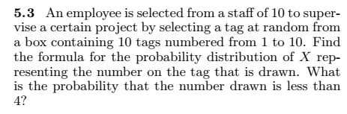

Miscellaneous problems (contd.)
Notes:
(5.3) f(x) = 1/10; P(X<4) = 3/10 (uniform distribution)
(5.12) n=9, p = 0.25 then P(X<4) = 0.8343 (binomial distribution)

Slide 27
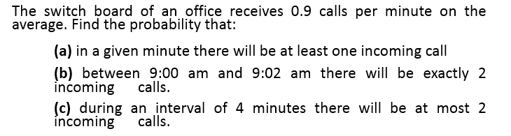
Miscellaneous problems (contd.)
Notes:
(3) N>27
(4) (a) P(X>=1) = 0.593 (b) P(X=2) = 0.2677 (c) P(X<=2) = 0.3027

Slide 28
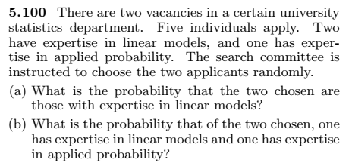
Miscellaneous problems (contd.)
Notes:
(a) 0.1 (b) 0.2 (more than two categories 🡪 multivariate hypergeometric)

Slide 29
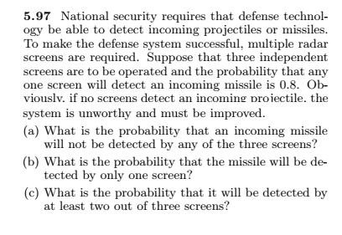
Miscellaneous problems (contd.)
Notes:
0.008 =P(X=0)
(binomial) 🡪 3C1(0.8)(0.2)^2= 0.096
P(X>=2) = P(X=2) + P(X=3) = 0.896

Slide 30
Miscellaneous problems (contd.)
A coin is biased with probability of a head 2/3. Find the probability that a head appears on the 5th trial.
End of Mid – II Syllabus
Notes:
2/243 = 0.008230

Slide 31
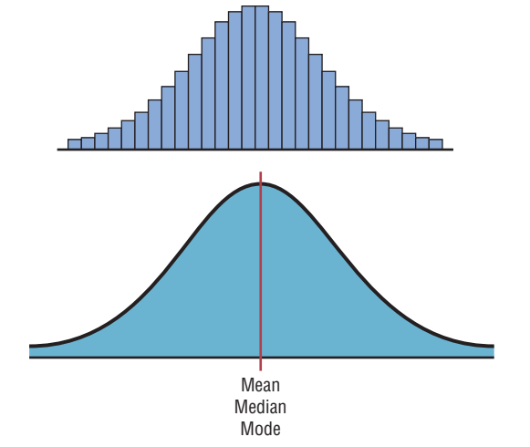
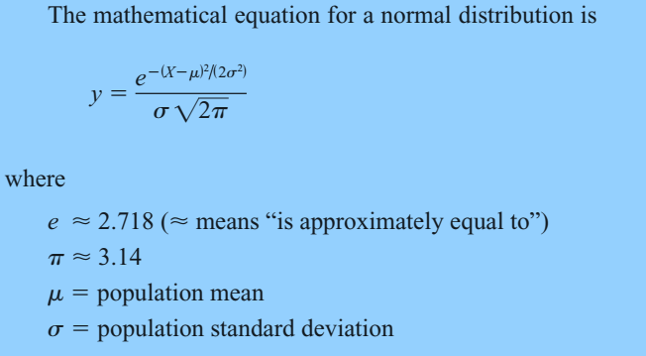
Normal / Gaussian Distribution

Slide 32
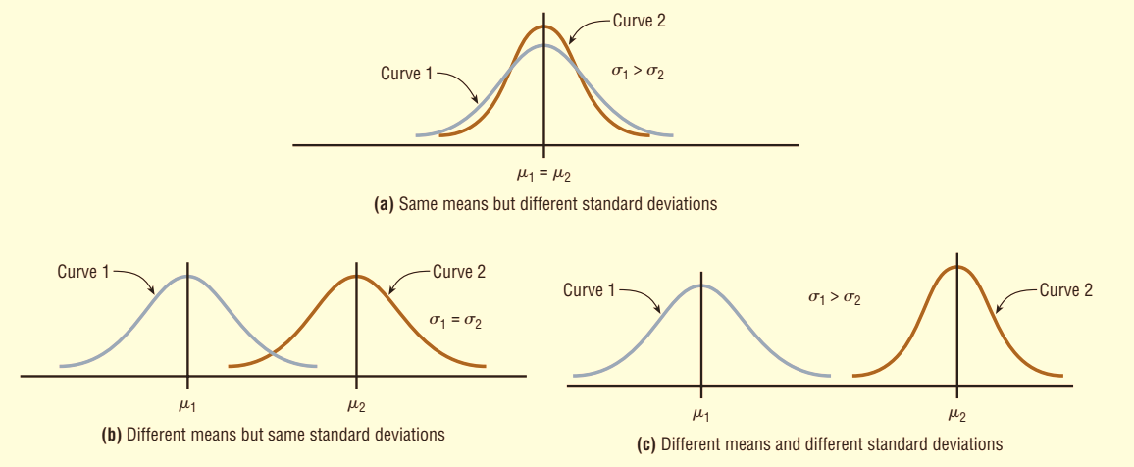
Shapes of Normal Distribution

Slide 33
Properties of Normal Distribution
A normal distribution is bell-shaped, symmetric and unimodal.
Mean = Median = Mode
The curve never touches the x axis. Theoretically, no matter how far in either direction the curve extends, it never meets the x axis—but it gets increasingly closer.
The total area under a normal distribution curve is equal to 1.00, or 100%.
The area under the part of a normal curve that lies within 1 standard deviation of the mean is approximately 0.68, or 68%; within 2 standard deviations, about 0.95, or 95%; and within 3 standard deviations, about 0.997, or 99.7%.

Slide 34


The Standard Normal Distribution
The standard normal distribution is a normal distribution with a mean of 0 and a standard deviation of 1.
The formula for the standard normal distribution is:
All normally distributed variables can be transformed into the standard normally distributed variable by using the formula for the standard score:
Notes:
The z score is actually the number of standard deviations that a particular X value is away from the mean.

Slide 35
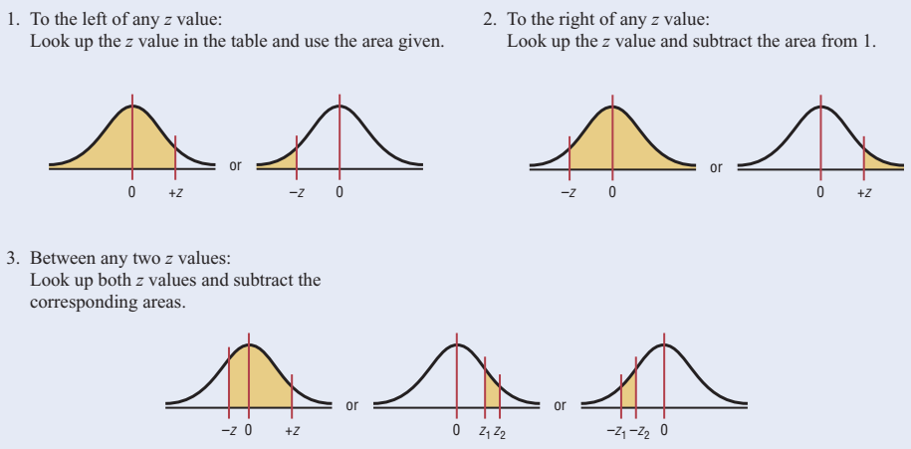
Areas under the standard Normal Curve

Slide 36

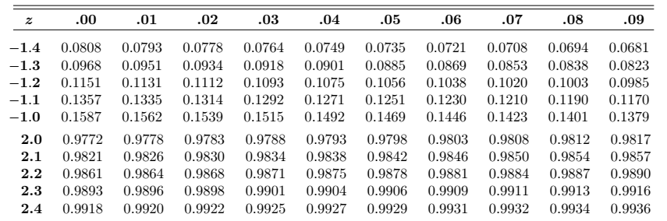
Example 01
Find the area to the left of z = 2.06
Find the area to the right of z = -1.19
Find the area between z = 1.68 and z = -1.37
Notes:
Incomplete Standard Normal table
P(z>-1.19) = 1 – 0.1170 = 0.8830
P(-1.37< z < 1.68) = 0.9535 – 0.0853 = 0.8682
The area under the standard normal distribution curve can also be thought of as a probability.

Slide 37
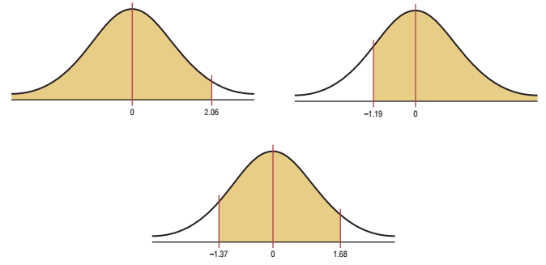
Example 01 (Contd.)

Slide 38
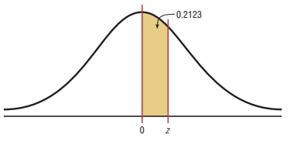
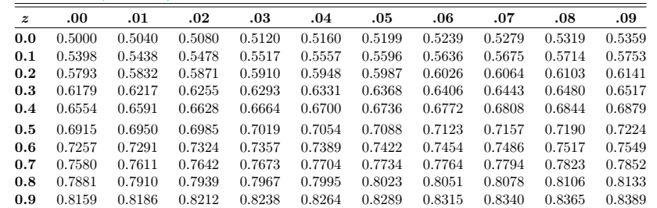
Example # 02
Find the z value such that the area under
the standard normal distribution curve b/w
0 and the z value is 0.2123.
Notes:
it is necessary to add 0.5000 to the given area of 0.2123 to get the cumulative area of 0.7123.

Slide 39
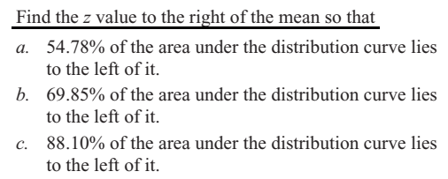
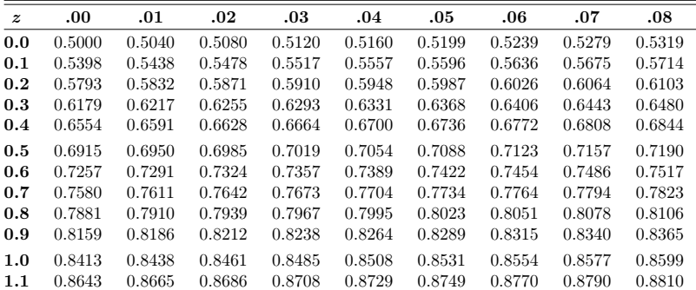
Example # 03:
Notes:
(a) 0.12 (b) 0.52 (c) 1.18

Slide 40
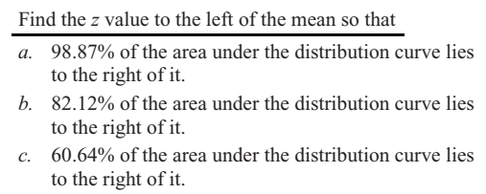
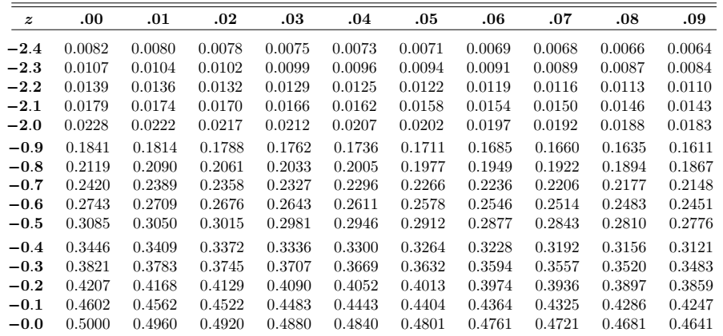
Example # 04:
Notes:
(a) 1 – 0.9887 = 0.0013 (z=-2.28) (b) 1 – 0.8212 = 0.1788 (z=-0.92) (c) 1 – 0.6064 = 0.3936 (z= -0.27)

Slide 41
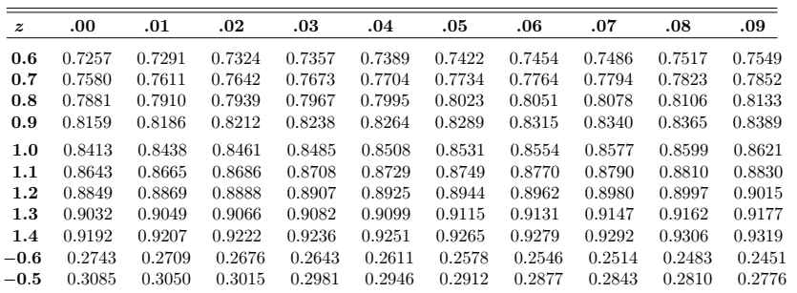
Example # 05
In the standard normal distribution, find the values of z for the 75th, 80th, and 92nd percentiles.
Notes:
(a) Z = +0.64 & -0.64. (Find two z values so that 48% of the middle area is bounded by them. )
(b) 0.67; 0.8416; 1.41

Slide 42
Example # 06 – 07
Summer Spending: A survey found that women spend on average $146.21 on beauty products during the summer months. Assume the standard deviation is $29.44. Find the percentage of women who spend less than $160.00. Assume the variable is normally.
Monthly Newspaper Recycling: Each month, an American household generates an average of 28 pounds of newspaper for garbage or recycling. Assume the standard deviation is 2 pounds. If a household is selected at random, find the probability of its generating:
a. Between 27 and 31 pounds per month b. More than 30.2 pounds per month
Notes:
Z = 0.47 (0.6808)
(a) Z = -0.6 & 1.5 🡪 0.6247

Slide 43
Example # 08 – 10
Coffee Consumption: Americans consume an average of 1.64 cups of coffee per day. Assume the variable is approximately normally distributed with a standard deviation of 0.24 cup. If 500 individuals are selected, approximately how many will drink less than 1 cup of coffee per day?
Police Academy Qualifications: To qualify for a police academy, candidates must score in the top 10% on a general abilities test. The test has a mean of 200 and a standard deviation of 20. Find the lowest possible score to qualify. Assume the test scores are normally distributed
Find K: Given a standard normal distribution, find the value of k such that (a) P (Z > k) = 0.3015 and (b) P (k < Z < -0.18) = 0.4197.
Notes:
(8) Z = -2.67 (500* 0.0038=1.9)
[9] the test value X that cuts off the upper 10% of the area under a normal distribution curve is desired (1 – 0.1000 = 0.9000) 🡪 Z=1.28 (X = 226)
K=-0.52 & for (b) k = -2.37 (find all area below z=-0.18=0.4286)🡪0.4286-0.4197=0.0089

Slide 44
Example # 11
In an industrial process, the diameter of a ball bearing is an important measurement. The buyer sets specifications for the diameter to be 3.0 ± 0.01 cm. The implication is that no part falling outside these specifications will be accepted. It is known that in the process the diameter of a ball bearing has a normal distribution with mean μ = 3.0 and standard deviation σ = 0.005. On average, how many manufactured ball bearings will be scrapped?
Notes:
(2.99 < x < 3.01)=P(-2.0 < z < 2.0) Now [P(Z < -2.0) + P(Z > 2.0) = 2(0.0228) = 0.0456. or 4.56% will be scrapped.

Slide 45
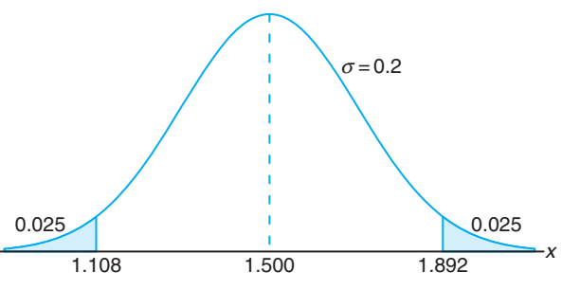
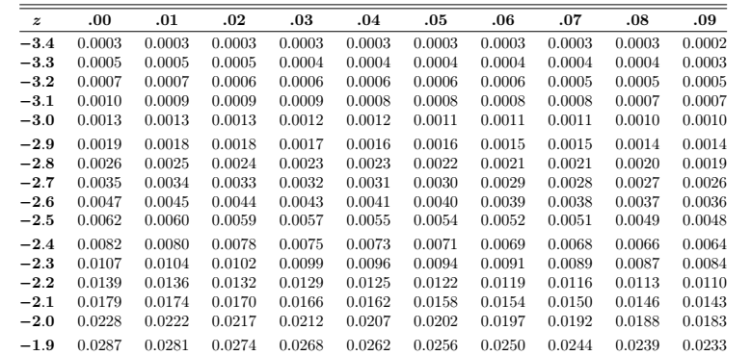
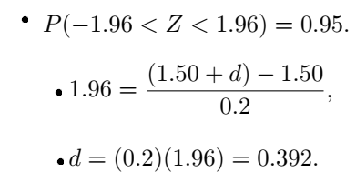
Example # 12
Gauges are used to reject all components for which a certain dimension is not within the specification 1.50 ± d. It is known that this measurement is normally distributed with mean 1.50 and standard deviation 0.2. Determine the value d such that the specifications “cover” 95% of the measurements.
Notes:
1-0.95=0.05 and 0.05/2=0.025 search for 0.025 in z-table that is correspond to -1.96

Slide 46
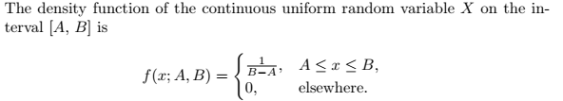
Continuous Uniform distribution
The distribution has two parameters “a” & “b”.
Mean = (a+b)/2 & Variance = (b – a)²/12
The distribution has no mode.
Odd order moments about mean vanish.
Skewness = 0 & Kurtosis = 9/5, therefore distribution is platykurtic.

Slide 47
Example # 13
Suppose that a large conference room at a certain company can be reserved for no more than 4 hours. Both long and short conferences occur quite often. In fact, it can be assumed that the length X of a conference has a uniform distribution on the interval [0, 4].
(a)What is the probability density function?
(b) What is the probability that any given conference lasts at least 3 hours?
Notes:
Pdf = ¼ over [0, 4] & P(X>=3) = ¼

Slide 48
SAMPLING DISTRIBUTION

Slide 49
Sampling Distribution
The probability distribution of a statistic is called a sampling distribution.
The sampling distribution of a statistic depends on the distribution of the population, the size of the samples, and the method of choosing the samples.

Slide 50
Sampling Distribution of Sample Means
Suppose a researcher selects a sample of 30 adult males and finds the mean of the measure of the triglyceride levels for the sample subjects to be 187 milligrams/deciliter.
Then suppose a second sample is selected, and the mean of that sample is found to be 192 milligrams/deciliter.
Continue the process for 100 samples.
187, 192, 184, . . . , 196
What happens?
The mean becomes a random variable.

Slide 51
Sampling Distribution of Sample Means (Contd.)
A sampling distribution of sample means is a distribution using the means computed from all possible random samples of a specific size taken from a population.
If the samples are randomly selected with replacement, the sample means, for the most part, will be somewhat different from the population mean µ. These differences are caused by sampling error.
Sampling error is the difference between the sample measure and the corresponding population measure.

Slide 52


Properties of the distribution of Sample Means
1. The mean of the sample means will be the same as the population mean i.e.
2. The standard deviation of the sample means will be smaller than the standard deviation of the population, and it will be equal to the population standard deviation divided by the square root of the sample size.

Slide 53
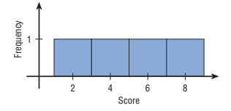
Example # 01
Suppose a professor gave an 8-point quiz to a small class of four students. The results of the quiz were 2, 6, 4, and 8. For the sake of discussion, assume that the four students constitute the population.
(a) Calculate population mean and standard deviation.
(b) Draw the graph of original distribution.
(c) Draw all possible samples of size 2 with replacement & Calculate mean of each sample.
(d) Construct Frequency distribution of Sample Mean and repeat Part (a) & (b)
Notes:
(a) Mean = 5 and SD = 2.236 (b) Graph is uniform
(c) 2^4 = 16 samples

Slide 54
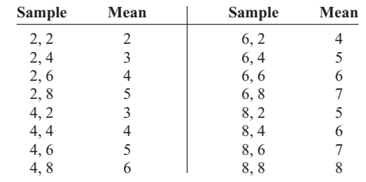
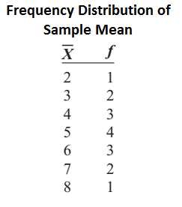
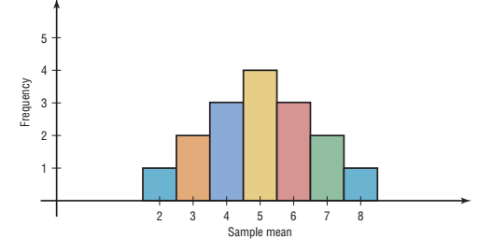
Example # 01 (contd.)

Slide 55
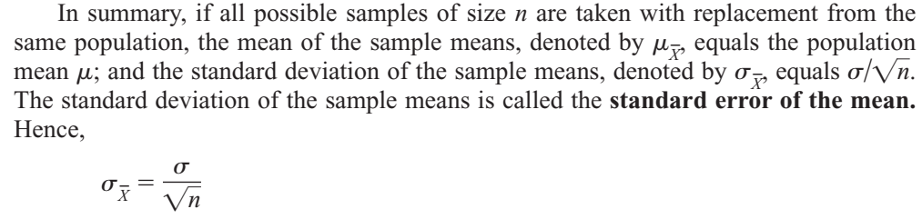
Example # 01 (Sampling distribution of sample means)
Notes:
Sample mean = 5 and sample SD = 1.581

Slide 56

Central Limit Theorem
As the sample size n increases without limit, the shape of the distribution of the sample means taken with replacement from a population with mean µ and standard deviation σ will approach a normal distribution. As previously shown, this distribution will have a mean µ and a standard deviation
If the sample size is sufficiently large, the central limit theorem can be used to answer questions about sample means in the same manner that a normal distribution can be used to answer questions about individual values. The only difference is that a new formula must be used for the z values. It is

Slide 57
Central Limit Theorem (Contd.)
It’s important to remember two points when you use the central limit theorem: 1. When the original variable is normally distributed, the distribution of the sample means will be normally distributed, for any sample size n. 2. When the distribution of the original variable might not be normal, a sample size of 30 or more is needed to use a normal distribution to approximate the distribution of the sample means. The larger the sample, the better the approximation will be.

Slide 58
Example # 02
Hours That Children Watch Television: A. C. Neilsen reported that children between the ages of 2 and 5 watch an average of 25 hours of television per week. Assume the variable is normally distributed and the standard deviation is 3 hours. If 20 children between the ages of 2 and 5 are randomly selected, find the probability that the mean of the number of hours they watch television will be greater than 26.3 hours.
Age of Vehicle: The average age of a vehicle registered in the United States is 8 years, or 96 months. Assume the standard deviation is 16 months. If a random sample of 36 vehicles is selected, find the probability that the mean of their age is between 90 and 100 months
Notes:
Z = 1.94 (0.0262) One can conclude that the probability of obtaining a sample mean larger than 26.3 hours is 2.62%. Z1 = -2.25 & Z2=1.50 (0.9210) the probability of obtaining a sample mean between 90 and 100 months is 92.1%;

Slide 59
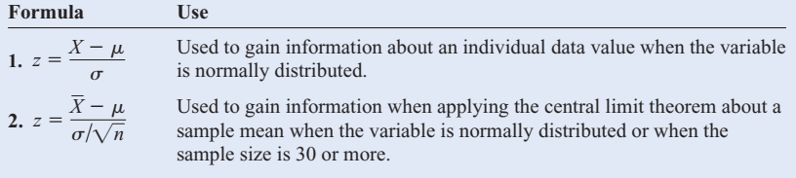
Summary of formulas

Slide 60

Finite Population Correction Factor
The formula for the standard error of the mean is accurate when the samples are drawn with replacement Or are drawn without replacement from a very large or infinite population.
Since sampling with replacement is for the most part unrealistic, a correction factor is necessary for computing the standard error of the mean for samples drawn without replacement from a finite population.
where N is the population size and n is the sample size.
This correction factor is necessary if relatively large samples are taken from a small population, because the sample mean will then more accurately estimate the population mean and there will be less error in the estimation.

Slide 61
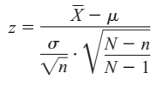
Finite Population Correction Factor (Contd.)
Therefore, the standard error of the mean must be multiplied by the correction factor to adjust for large samples taken from a small population. Finally, the formula for the z value becomes:
When the population is large and the sample is small, the correction factor is generally not used, since it will be very close to 1.00.

Slide 62
The Normal Approximation to the Binomial Distribution
A normal distribution is often used to solve problems that involve the binomial distribution since when n is large (say, 100), the calculations are too difficult to do by hand using the binomial distribution.
When p is approximately 0.5, and as n increases, the shape of the binomial distribution becomes similar to that of a normal distribution.
The larger n is and the closer p is to 0.5, the more similar the shape of the binomial distribution is to that of a normal distribution.
As a rule of thumb, statisticians generally agree that a normal approximation should be used only when np and nq are both greater than or equal to 5.

Slide 63
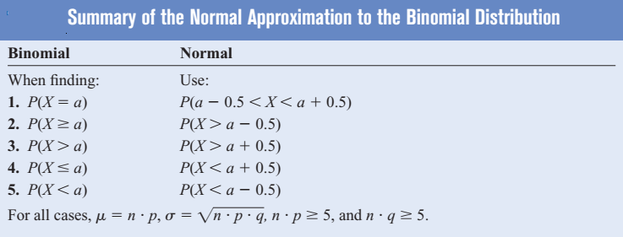
Normal Approximation (Contd.)
A correction for continuity is a correction employed when a continuous distribution is used to approximate a discrete distribution.

Slide 64
Example 01 & 02
Reading While Driving: A magazine reported that 6% of American drivers read the newspaper while driving. If 300 drivers are selected at random, find the probability that exactly 25 say they read the newspaper while driving.
Batting Averages: If a baseball player’s batting average is 0.320 (32%), find the probability that the player will get at most 26 hits in 100 times at bat.
Notes:
Reading while Driving: Np=18 & nq= 282 ; P(24.5 < X < 25.5) = P(1.82 < Z < 1.58) = 0.0227
Batting Avg: np=32 & nq=68; P(X < =26) =P(X < 26.5); z=-1.18 or 0.1190.

